Slide 1



Slide 2
What is Jenkins ?
Jenkins is an open source automation tool written in Java programming language that allows continuous integration.
Jenkins builds and tests our software projects which continuously making it easier for developers to integrate changes to the project, and making it easier for users to obtain a fresh build.
It also allows us to continuously deliver our software by integrating with a large number of testing and deployment technologies
Jenkins offers a straightforward way to set up a continuous integration or continuous delivery environment for almost any combination of languages and source code repositories using pipelines, as well as automating other routine development tasks.
With the help of Jenkins, organizations can speed up the software development process through automation. Jenkins adds development life-cycle processes of all kinds, including build, document, test, package, stage, deploy static analysis and much more.
Jenkins achieves CI (Continuous Integration) with the help of plugins. Plugins is used to allow the integration of various DevOps stages. If you want to integrate a particular tool, you have to install the plugins for that tool.

Slide 3

Why Jenkins ?
Master CI/CD Pipelines: Automate building, testing, and deploying code efficiently.
In-Demand DevOps Skill: Jenkins knowledge is valuable for roles like DevOps Engineer and Build Engineer.
Automate Repetitive Tasks: Save time and reduce human error in software development.
Wide Tool Integration: Works with numerous tools like Git, Maven, Docker, and Kubernetes.
Boost Team Collaboration: Facilitates continuous integration and feedback, improving team workflows.
Scalability: Supports large-scale projects with distributed builds.
Career Growth: High demand for Jenkins expertise opens better job opportunities.

Slide 4
Features of Jenkins
Easy Insatallation : Jenkins is a platform-agnostic, self-contained Java-based program, ready to run with packages for Windows, Mac OS, and Unix-like operating systems.
Easy cofiguration : Jenkins is easily set up and configured using its web interface, featuring error checks and a built-in help function.
Available pluggings : There are hundreds of plugins available in the Update Center, integrating with every tool in the CI and CD toolchain.
Extensible : Jenkins can be extended by means of its plugin architecture, providing nearly endless possibilities for what it can do.
Easy Distribution : Jenkins can easily distribute work across multiple machines for faster builds, tests, and deployments across multiple platforms.
Free open source : Jenkins is an open-source resource backed by heavy community support.

Slide 5
Advantages of Using Jenkins
It is an open source tool.
It is free of cost.
It does not require additional installations or components. Means it is easy to install.
Easily configurable.
It supports 1000 or more plugins to ease your work. If a plugin does not exist, you can write the script for it and share with community.
It is built in java and hence it is portable.
It is platform independent. It is available for all platforms and different operating systems. Like OS X, Windows or Linux.
Easy support, since it open source and widely used.
Jenkins also supports cloud based architecture so that we can deploy Jenkins in cloud based platforms.

Slide 6

Disadvantages of Using Jenkins
Its interface is out dated and not user friendly compared to current user interface trends.
Not easy to maintain it because it runs on a server and requires some skills as server administrator to monitor its activity.
CI regularly breaks due to some small setting changes. CI will be paused and therefore requires some developer's team attention.

Slide 7
What is continuous Integration
Continuous integration is a development practice in which developers are required to commit changes to source code in a shared repository several times a day. Every commit is then build and this allows the teams to detect
It then bring following benefits to software development:
1.catch issues fast and nip them in the build.
2.everyone can see what's happening.
3.Automate the build.
4.Continuous integration leads to Continuous deployment allowing us to deliver software more rapidly.

Slide 8
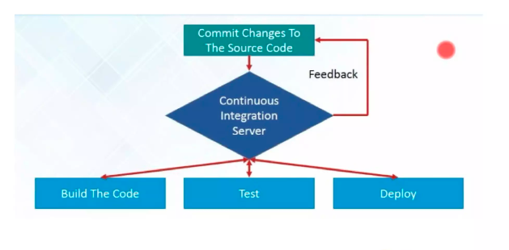
Continuous Integration

Slide 9
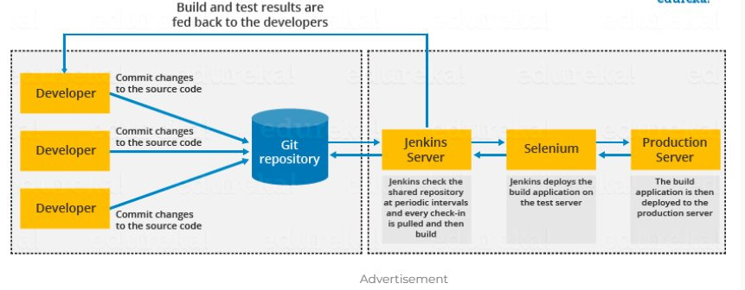
Jenkins Work Flow

Slide 10
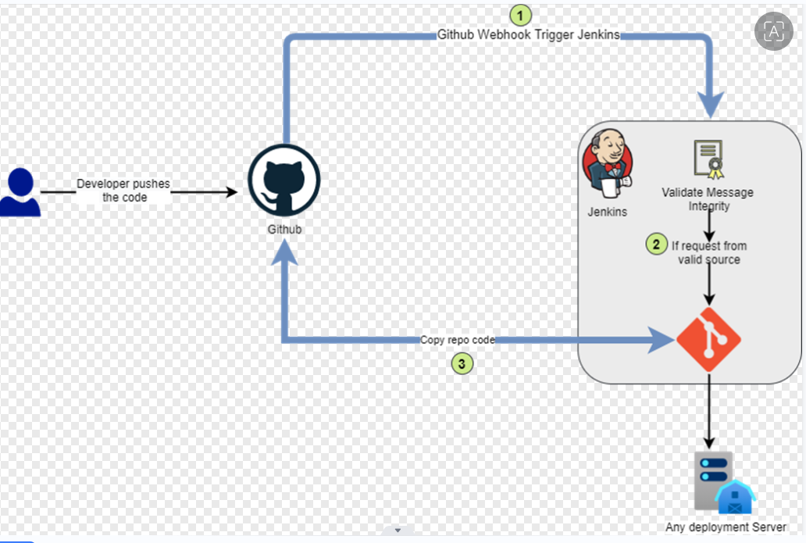
How Jenkins work
First of all, a developer commits the code to the source code repository. Meanwhile, the Jenkins checks the repository at regular intervals for changes.
Soon after a commit occurs, the Jenkins server finds the changes that have occurred in the source code repository. Jenkins will draw those changes and will start preparing a new build.
If the build fails, then the concerned team will be notified.
If built is successful, then Jenkins server deploys the built in the test server.
After testing, Jenkins server generates a feedback and then notifies the developers about the build and test results.
It will continue to verify the source code repository for changes made in the source code and the whole process keeps on repeating.

Slide 11
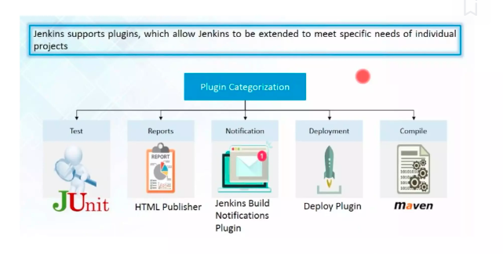
Plugin Categarizaion

Slide 12
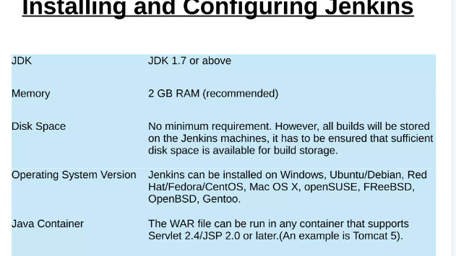

Slide 13
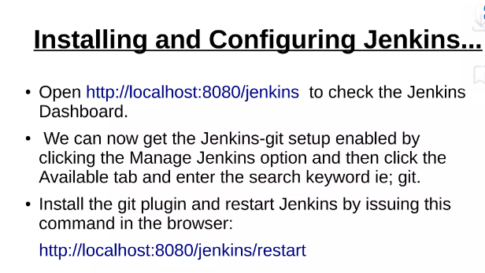

Slide 14
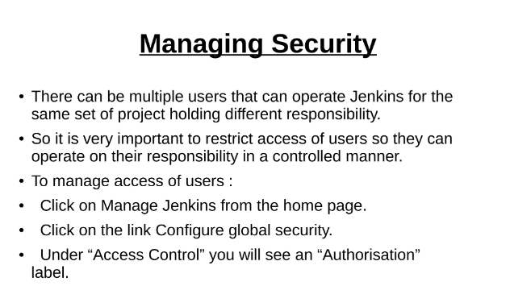

Slide 15
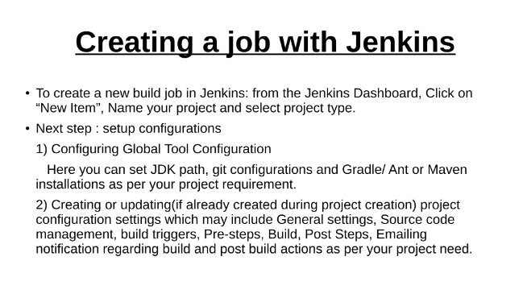

Slide 16
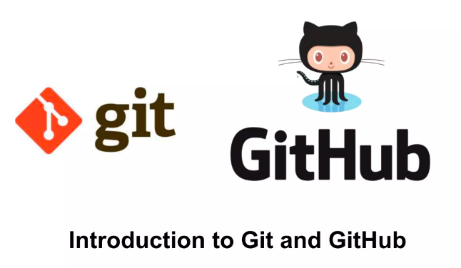

Slide 17

Git was created by Linus Torvalds in 2005 to develop Linux Kernel. It is also used as an important distributed version-control tool .
Git is an open-source distributed version control system.
GIT is mainly used for "to track the code changes".

Slide 18
What is Git ?
Git is an open-source distributed version control system. It is designed to handle minor to major projects with high speed and efficiency. It is developed to co-ordinate the work among the developers.
GIT is mainly used for "to track the code changes".
Git was created by Linus Torvalds in 2005 to develop Linux Kernel. It is also used as an important distributed version-control tool for the DevOps.
Git is easy to learn, and has fast performance.
It is superior to other SCM tools like Subversion, CVS, Perforce, and ClearCase.

Slide 19
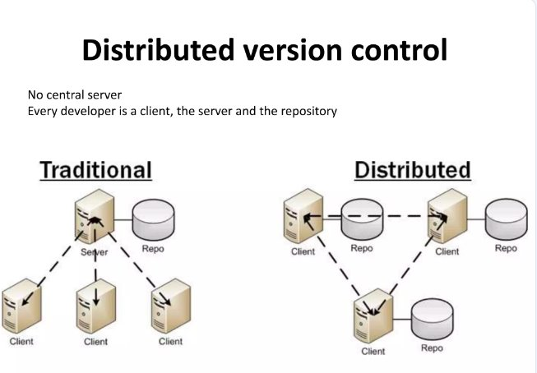

Slide 20
Features of Git
Version Control System: Git keeps track of every change you make to your project files. You can go back to previous versions is any requirement arises.
Repositories: A Git repository (or repo) is like a project's central hub where everything related to your work is stored and managed. There are two main types:
Local Repository: This is a copy of the repository which is stored in your computer. You can work on your project and make changes here.
Remote Repository: This is stored on a server, like GitHub, where you and others can share and work on a project.
Commits: Every time you make changes and save them in Git, these are called commits. The repository keeps track of all the commits you have made.
Branches: A repository allows you to create Branches and work on new features and fixes. For example, you can have a "main" branch for stable code and a "feature" branch for new features you're developing.
Merging: Once you are done with the branches you have made, you can merge those branches into main branch. This adds the changes you have made in the rest of the project.
Cloning: Cloning is a process of making a complete copy of Git repository. It's like copying the entire project from central location ( like website) to your own computer.

Slide 21

Why using Git ?
Distributed System: Every developer has a complete local copy of the project, allowing for offline work and increased resilience.
Performance: Git is fast and efficient, handling large projects with ease.
Branching and Merging: Git's lightweight branching and easy merging facilitate parallel development and feature isolation.
Collaboration: Tools like GitHub enhance team collaboration, code reviews, and project management.
Track Changes: Git tracks changes and maintains a history, making it easy to revert to previous versions.

Slide 22

Steps to Setup a Git
.Install Git: Download and install Git from the official Git website.
Configure Git: Set up your username and email
git config --global user.name "Your Name"
git config --global user.email "your.email@example.com"

Slide 23
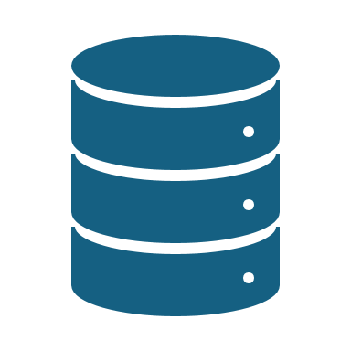
Git commands
$git init : creates a local repository
$git clone <path URL> : checkout a repository and create a local copy of it
$git status : to see the state of your files (modified, added ,remote...)
$git add<file name> : add files to staging your area
$git commit –m "message" : commit a stage file
$git checkout : switching between branches
$git log : list the commits
$git rm filename : deleting files
$git branch <name> : create a brach
$git checkout –b branch name : create a branch and also switch that branch
$git mv file1 file2 : moving from one file to another file

Slide 24
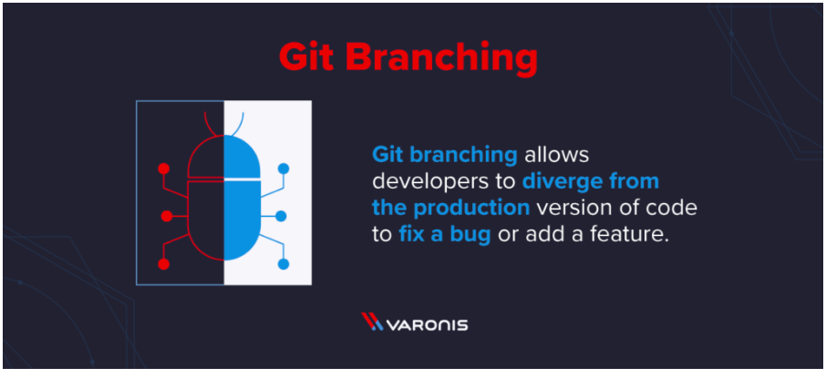

Slide 25
What is git branch ?
Git branching allows developers to diverge from the production version of code to fix a bug or add a feature.
Developers create branches to work with a copy of the code without modifying the existing version. You create branches to isolate your code changes, which you test before merging to the main branch (more on this later).
There is nothing special about the main branch. It is the first branch made when you initialize a Git repository using the git init command.

Slide 26
Advantages of Git
Distributed System: Everyone has the complete project history on their computer, so you can work offline and there's no single point of failure.
Fast: Git handles large projects quickly and efficiently.
Branching and Merging: You can create branches to work on new features and merge them easily, without affecting the main project.
Collaboration: Git makes it easy for teams to work together, review each other's code, and manage projects.
Change Tracking: Git keeps a record of all changes, so you can go back to previous versions if needed.
Free and Open Source: Git is free to use and has a large community for support.

Slide 27

Disadvantages of Git
Learning Curve: Git can be complex to learn, especially for beginners.
Complex Commands: Some commands and operations can be difficult to understand and remember.
Merge Conflicts: Resolving conflicts when merging branches can be challenging.
Storage: The local repository can take up significant space on your computer.
Setup and Configuration: Initial setup and configuration can be time-consuming.
Not Ideal for Large Binary Files: Git is less efficient at handling large binary files (e.g., videos, images).

Slide 28
Git Workflow
A Git workflow is a set of guidelines for using Git in a structured and efficient manner. Here’s a simple and common Git workflow:
Clone Repository: git clone git@github.com:username/repository.git
Create Branch: git checkout -b feature-branch-name
Check Status: git status
Stage Changes: git add filename or git add .
Commit Changes: git commit -m "Add feature X"
Push Branch: git push origin feature-branch-name
Create Pull Request: On Github/other service
Update Local Repository: git checkout main, git pull origin main
Delete Branch: git branch -d feature-branch-name, git push origin --delete feature-branch-name

Slide 29
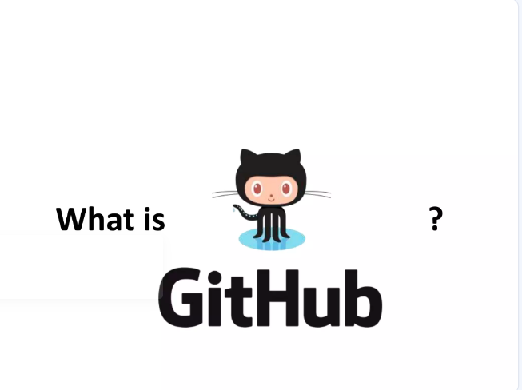


Slide 30

What is GitHub?
GitHub is a web-based platform that uses Git, a version control system, to help developers manage and track changes in their code.
It allows multiple people to collaborate on a project, track revisions, and contribute to code from anywhere in the world. GitHub offers both free and paid plans, catering to individuals and large organizations alike.

Slide 31
Benefits of GitHub
GitHub can be separated as the Git and the Hub. GitHub service includes access controls as well as collaboration features like task management, repository hosting, and team management.
The key benefits of GitHub are as follows.
It is easy to contribute to open source projects via GitHub.
It helps to create an excellent document.
You can attract recruiter by showing off your work. If you have a profile on GitHub, you will have a higher chance of being recruited.
It allows your work to get out there in front of the public.
You can track changes in your code across versions.

Slide 32
Key Features of GitHub
1. Version Control
GitHub’s core functionality is based on Git, which allows you to keep track of changes in your code over time. This means you can always revert to a previous version if something goes wrong, compare different versions, and understand the history of your project.
2. Repositories
A repository (or repo) is a central place where all the files for a project are stored. Each repository can hold multiple files and folders, and it tracks the history of every change made. Repositories can be public (accessible to everyone) or private (restricted access).
3. Branches
Branches are a crucial feature in GitHub that enable parallel development. You can create a branch to work on a new feature or fix a bug without affecting the main codebase. Once your changes are ready, you can merge the branch back into the main branch.
4. Pull Requests
Pull requests are a way to propose changes to a repository. When you submit a pull request, you’re asking the project maintainers to review and merge your changes into the main codebase. This feature promotes collaboration and ensures code quality through peer review.
5. Issues and Project Management
GitHub provides tools to track bugs, enhancements, and other tasks through the Issues feature. You can create issues, assign them to team members, and track their progress. GitHub also offers project boards for more advanced project management.
6. Actions and Automation
GitHub Actions allow you to automate workflows, such as running tests or deploying code, directly from your repository. This feature enhances productivity and ensures consistency across development processes.

Slide 33
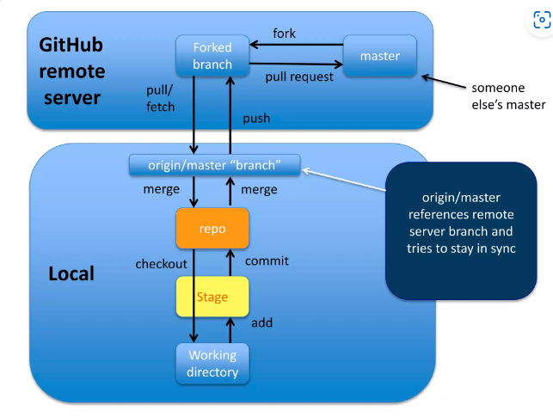

Slide 34
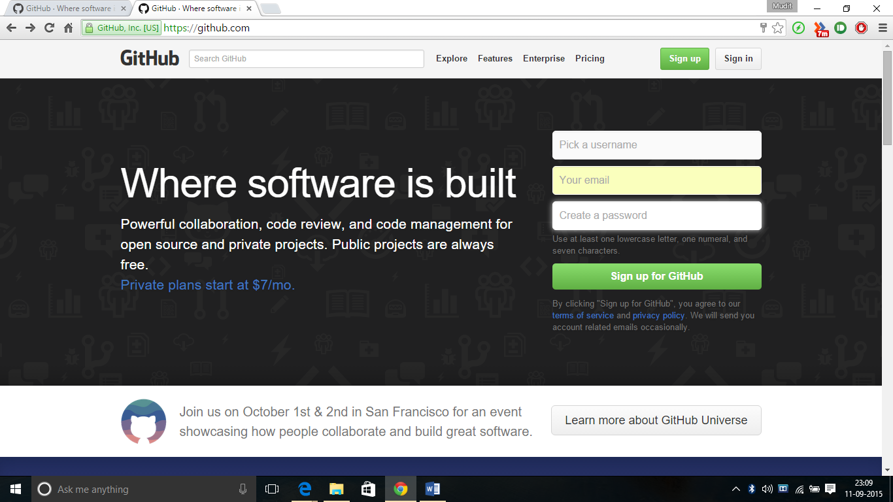
Creating a GitHub Account
Step 1: Go to github.com and enter the required user credentials asked on the site and then click on the SignUp for GitHub button.

Slide 35
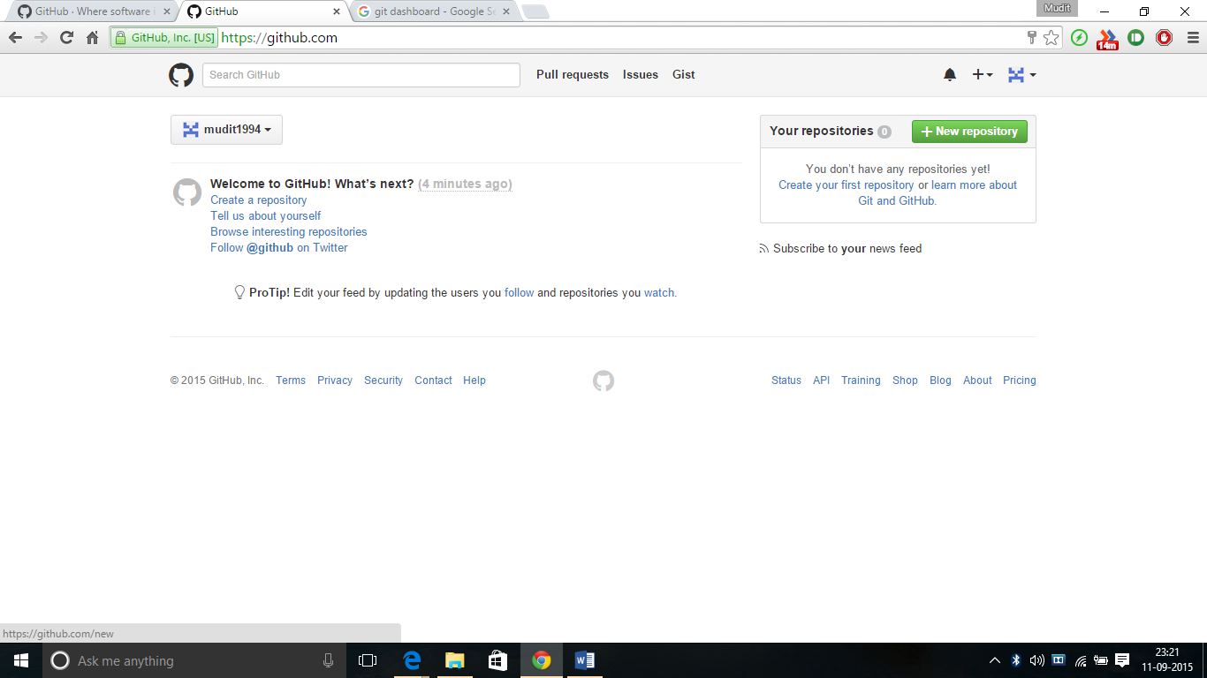
Creating a Repository
To create a new repository on GitHub, follow these steps:
Step 1: Then Click on Finish Sign Up. The account has been created. The user is automatically redirected to your Dashboard.

Slide 36
To create a new repository on GitHub, follow these steps:
Go to GitHub and log in.
Click the “+” icon in the upper right corner and select “New repository.”
Enter a repository name and description.
Choose whether the repository will be public or private.
Click “Create repository.”

Slide 37
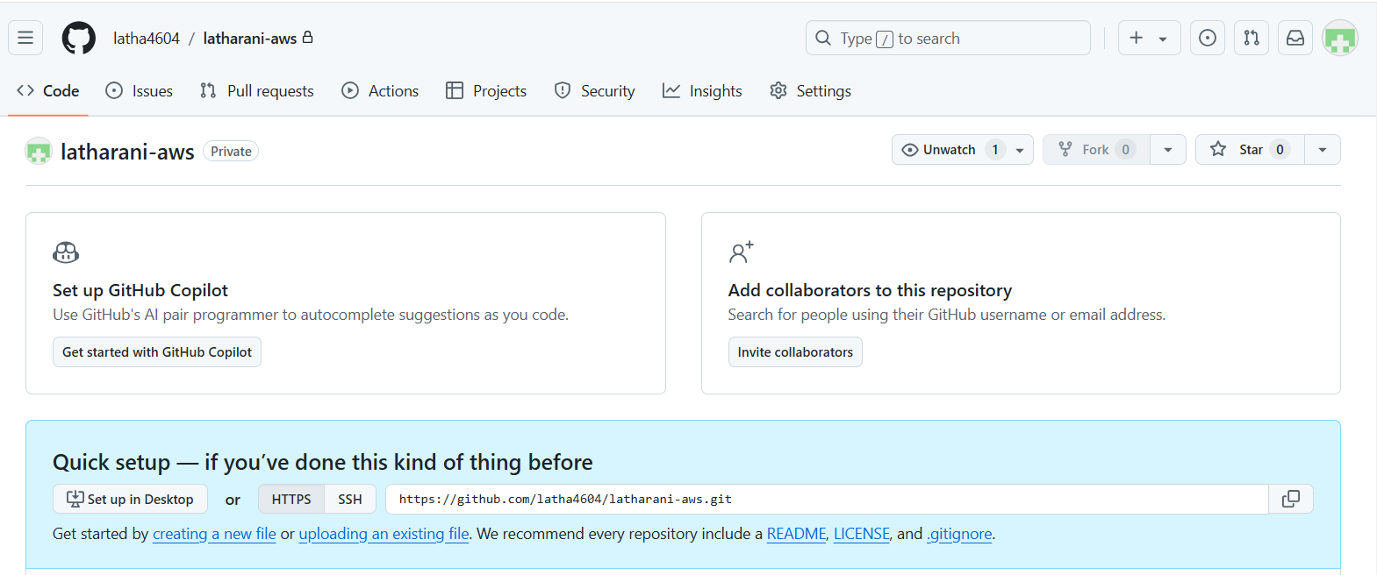
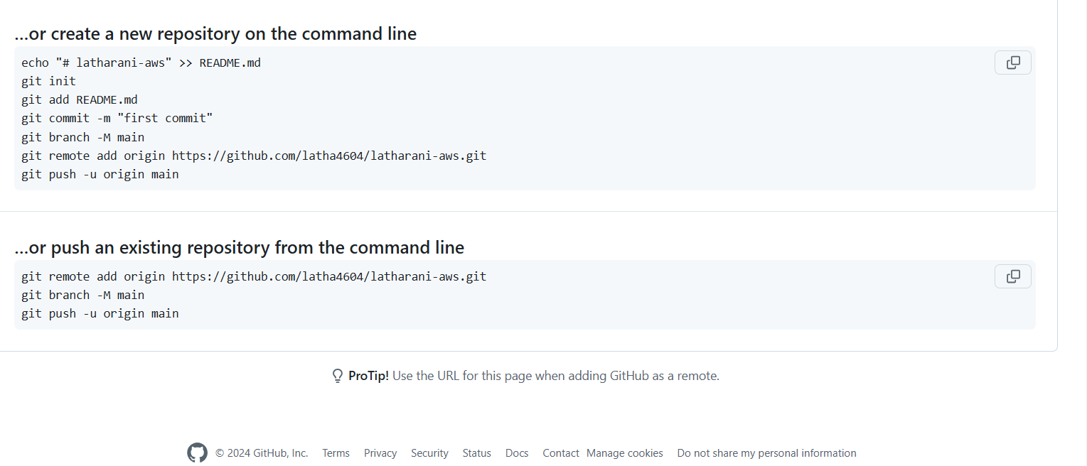

Slide 38
Copying(cloning) files from remote repo to local repo
Git clone url <new-dir-name>
How do I link local repo to a remote repo
Git remote add <alias><URL>
Which remotes linked to
Git remote
Pushing to a remote repo
Git push <loca branch name><branch name>
Fetching from a remote repo
Git fetch <remote repo name>
Pulling to local repo
Git pull <remote branch name><local branch name>
Merging into two branches
Git merge <branch name ><another branch name>

Slide 39
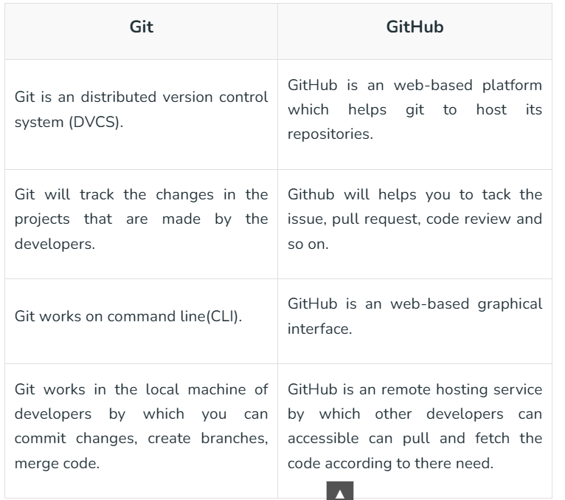
Difference between Git & GitHUB

Slide 40
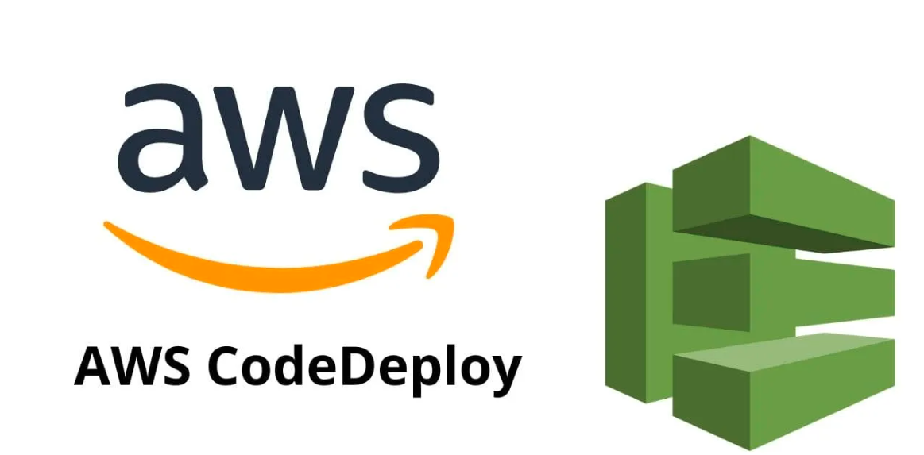

Slide 41
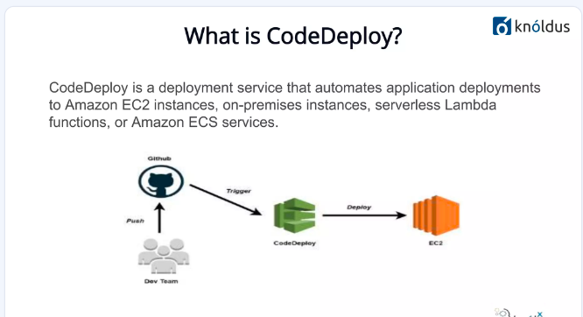

Slide 42

What is AWS Code Deploy ?
CodeDeploy is a deployment service that automates application deployments to Amazon EC2 instances, on-premises instances, serverless Lambda functions, or Amazon ECS services
AWS CodeDeploy is a tool that helps put new versions of computer programs on different machines.
It moves your updated files to the right places automatically.
This saves time and reduces mistakes that can happen when doing it by hand.
CodeDeploy can update one computer or many at once.
If there's a problem, it can also switch back to the old version quickly. It's useful for people who need to update their programs often and on many computers.

Slide 43
What is AWS CodeDeploy used for?
AWS CodeDeploy is a tool used to automatically put new or updated programs on different types of computers
It can work with AWS computers that run without a server, regular computers in your office, AWS computers you rent, and computers that run lots of small programs in containers.
CodeDeploy can update many kinds of files, like main program files, web pages, settings files, small helper programs, and even pictures and videos.
You can keep your program files in places like GitHub, Bitbucket, or AWS S3, and CodeDeploy will get them from there without changing your original files.
This tool helps you add new things to your programs easily, keeps your programs running while updating them, and handles tricky updates without making mistakes.
CodeDeploy makes it safer and easier to update your programs than doing it by hand, which helps avoid problems that can happen with manual updates.

Slide 44
Overview of CodeDeploy compute platform
EC2/On-Premises
This includes computers in your office and AWS computers you rent (called EC2). CodeDeploy can put all kinds of files on these, like program files, settings, and pictures. It can update these computers in two ways: by changing files directly or by setting up new computers and then switching to them.
AWS Lambda
This is for special programs that run for a short time when needed. CodeDeploy can update these programs in different ways, like changing a little bit at a time or all at once.
Amazon ECS
This is for programs that run in containers, which are like small, separate areas on a computer. CodeDeploy updates these by making a new set of containers with the updated program, then slowly switching people from the old version to the new one. When everyone is using the new version, the old one is removed.

Slide 45
Benefits of Amazon CodeDeploy
Automation of Deployments
CodeDeploy does all the work of updating your programs for you. It can update programs on different types of computers at the same time, whether they're in AWS or in your own office. This helps you update quickly and reliably.
Minimizes Downtime
CodeDeploy tries to keep your programs working while it updates them. It makes changes bit by bit and checks if everything is okay. If something goes wrong, it can undo the changes and go back to the old version.
Centralized Control
You can start updates and see how they're going from one place - the AWS website or by using special commands. CodeDeploy tells you when and where each update happened. It can even send you messages to let you know what's happening.
Easy Adaptation
CodeDeploy works the same way no matter what kind of program you're updating or what language it's written in. You can use it with other tools you might already use for updating programs, like GitHub or Jenkins.

Slide 46
Which type of deployments are supported by AWS CodeDeploy?
In-place updates
This is used for regular computers. It updates the program on each computer one by one. While updating, it stops the old version, puts the new version on, and then starts it again. It can also take the computer out of use while updating, so users don't see any problems.
Blue/green updates
This sets up a whole new set of computers with the new version. It lets you test the new version before letting everyone use it. There are three ways to switch users to the new version:
Bit by bit : It moves users to the new version in two steps.
Slowly : It moves users to the new version a little at a time, at set times.
All at once : It switches all users to the new version right away.
Blue/green updates are safer because you can easily go back to the old version if there are problems. They work with all types of AWS computers.

Slide 47
Conclusion
AWS CodeDeploy is a helpful tool that makes updating your programs easier and safer.
It can update programs on different types of computers, either by changing them directly or by setting up new computers with the updated version.
CodeDeploy lets you choose how quickly to switch the users to the new version and it can easily go back to the old version if there are problems.
This tool is great for the both small and big companies that want to keep their programs up-to-date without causing the trouble for their users.

Slide 48


PRESENTED BY Latharani SPESHWAY SOLUTIONS Pvt Ltd

